Slide 1
Woodland Public Schools
Facilities and Safety Report
September 2018

Slide 2
FACILITIES REPORT
Continued
Bus Accident Robinson Road A serious accident occurred a few weeks ago where a student was struck by a bus as it was leaving the bus parking area at the rear of WHS. The student entered the road as the bus was heading south on Robinson Rd. The driver was not able to see the student due to the parked cars. When the student entered the road, there was not time for the driver to react to the situation. The student was struck by the bus passenger side mirror, and received a head laceration. This accident could have been far worse had the student made it further into the road. I met with the City on the following Monday to explore options to improve visibility along this road. We will be installing No Parking signs along Robinson, that will not allow parking during school hours (7:30-4:30). The Safety committee also walked the accident site at our last meeting.
Yale Play System The new play structure for Yale was received 34 days late, well after school started. To add insult to injury, the installation drawings were dimensionally incorrect. This added an additional few days of delay, as we were well into the assembly when the problem was found. After discussing the issue with the manufacturer and making field changes to the main poles that are the foundation of the system, we were able to complete the system this last week.

Slide 3
(Continued)
FACILITIES REPORT
Summer Work Winding Down With it being a short summer, many of the project scheduled have ebbed into the school year. There are still many items that are in progress that are in the finishing stages. My priority was to complete all safety items and activities that directly support classroom activities.
Yale Water System We have had at least 4 incidents over the last 3 years, where the Yale water system has hit the action level for chloroform. The Cowlitz County Department of Health indicated that the level of chloroform at the last event was still safe. Regardless of this, I shifted to bottled water as a precaution until the system was flushed and subsequent testing was completed. In order to mitigate this issue permanently, I met with Olsen engineering a few weeks ago to design a chlorination system for the Yale water supply. I intend to move forward with this activity. This project includes some minor electrical work; the installation of a “doghouse” over the well head, and the installation of a small storage tank and injection system.

Slide 4
(Continued)
FACILITIES REPORT
Plumbing Clog WMS The WMS plumbing system that supports the east end of the Yellow Hall and that services the kitchen, restrooms and all areas west, including the District office, clogged 100% on a Friday afternoon. The source of the clog was a tree root that had entered the pipe through a hole in the bottom of the original 6 inch concrete pipe, that leads to the main City sewer on Second Street. Multiple attempts to clear the obstruction with a jet system and snake had no effect. Repair required excavation of the island area directly outside the District Office, and part of the curbing and blacktop. I was able to secure an excavator on Saturday, to dig up the site and make repairs the same day. School operations were unaffected.

Slide 5
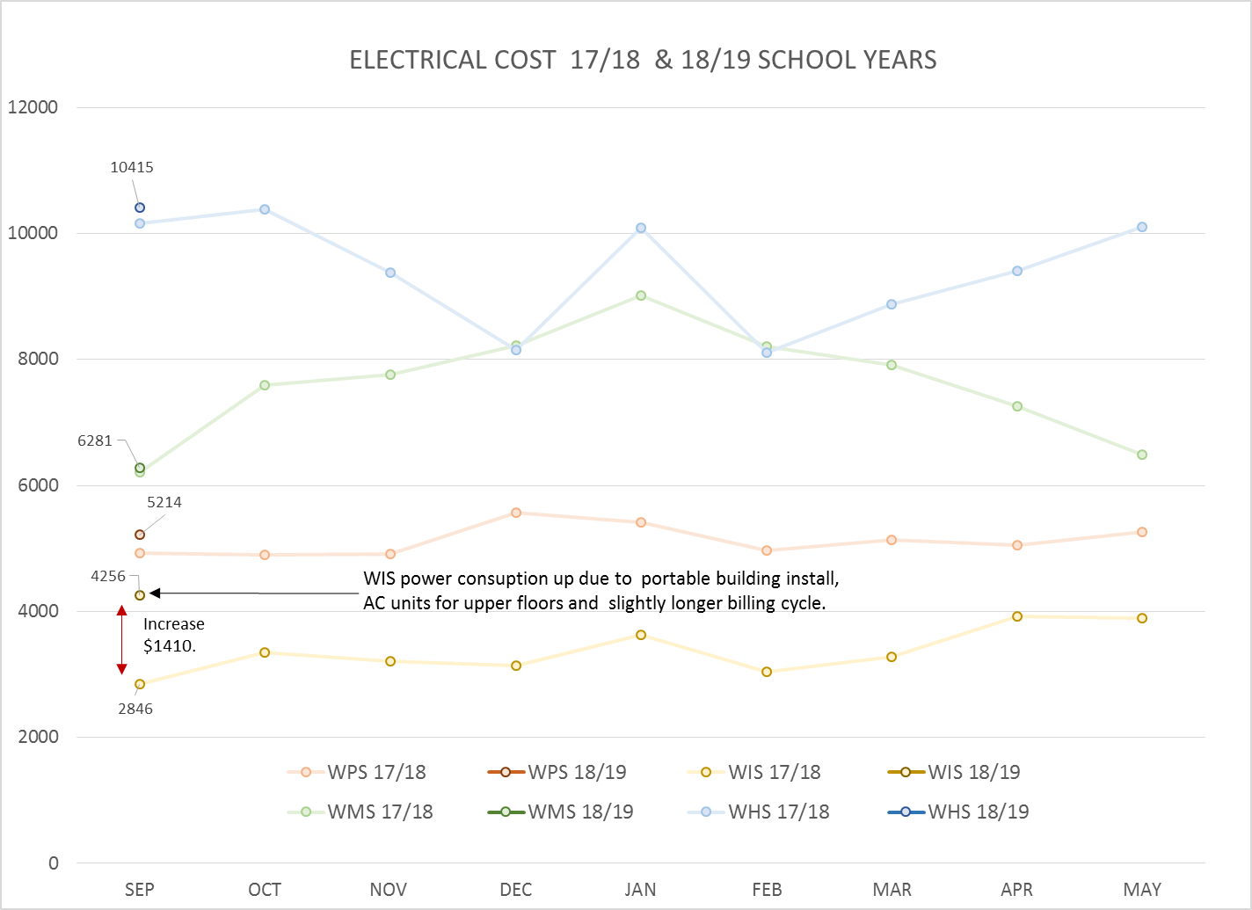
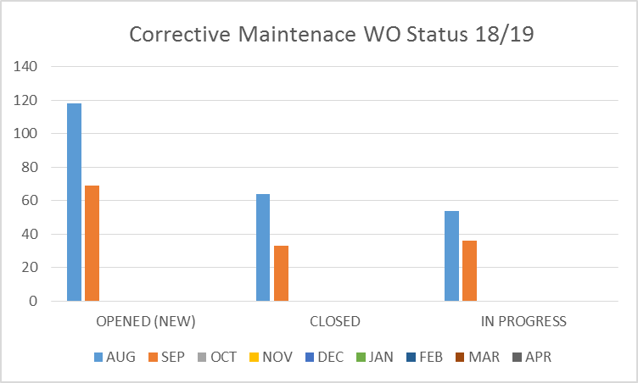
FACILITY CHARTS – POWER COST AND WORK ORDER STATUS

Slide 6
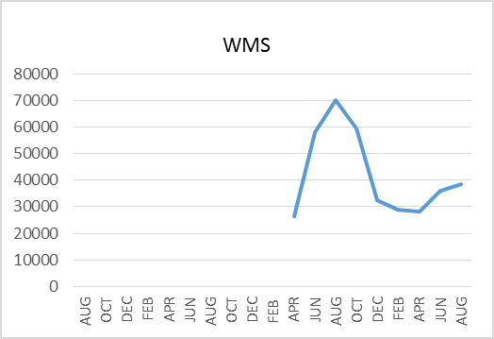
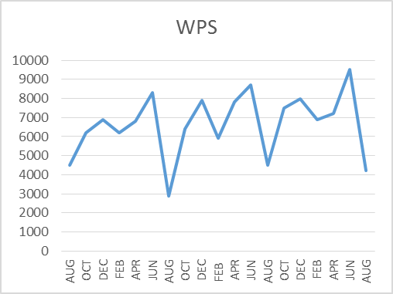
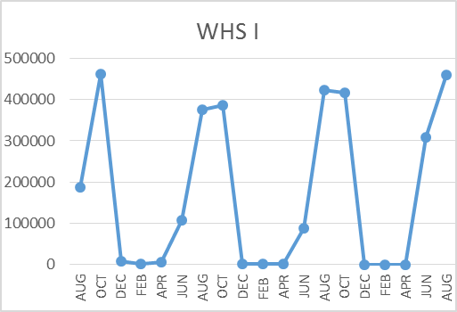
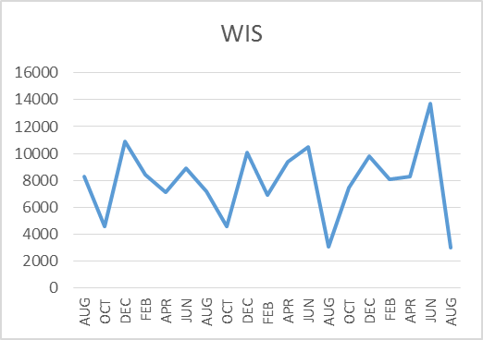
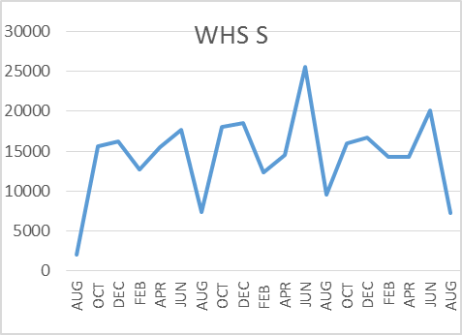
FACILITY CHARTS – WATER USAGE WHS, WIS, WMS, WPS
Note
Water charts are updated every two
months. Next update to these charts
in November 2018.
The WMS chart has been reconfigured to include the following 7 meters: 755 Park high and low flow, BO and Team High, PIT house, bus barn, athletic field and DO. All of these meters are totaled on the WMS graph, but each data point is recorded separately to aid in identifying leaks.

Slide 7
SAFETY CHARTS
Accidents for the Month
There were 27 accident/incidents for the month; 13 students and 14 staff.
Staff Accidents/Incidents
All 14 staff incidents were the result of student behavior; 1 at WIS and 13 at WPS. Most injuries were the result of biting, kicking, punching or throwing of objects.
Student Accidents/Injuries
WPS – Student broke arm in fall from play equipment.
WIS – Student choked on potato chip.
WIS – Student ran into tree; head laceration.
WHS - Students involved in fight; minor bruising and tenderness (2).
WHS - Students received minor sprains; bruises (5).
WHS – Student lacerated finger while cutting a potato.
WHS – Student had racing heart after consuming energy drink and taking medication.
WHS - Student injured arm while manipulating wheelchair.

Slide 8
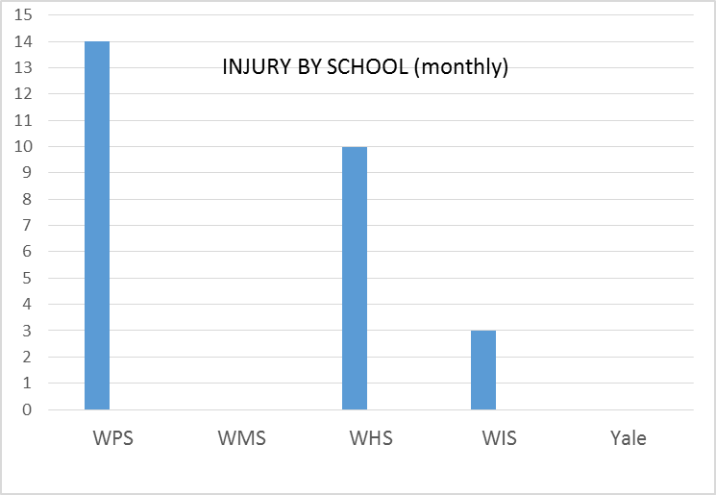
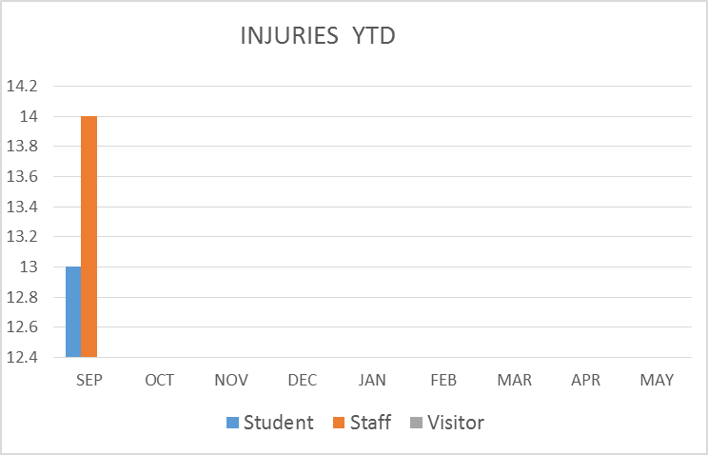
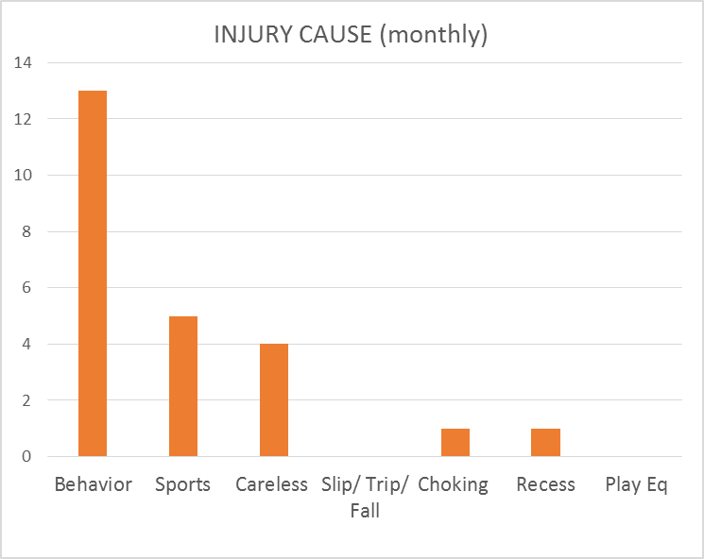
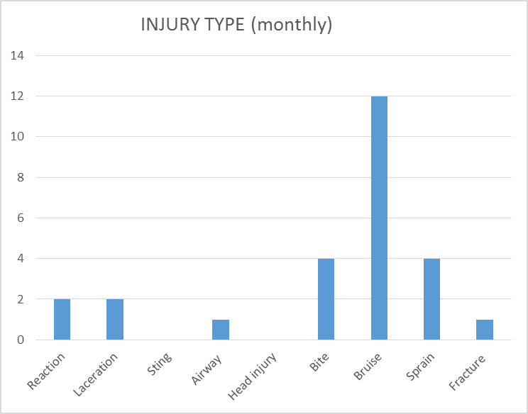
SAFETY CHARTS

